Slide 1

MEDIA
CENTER
MARCH–JUNE 2026
Activity overview

Slide 2

MEDIA CENTER:
RAPID CIVIL SOCIETY RESPONSE
FOR FAIR ELECTIONS
Project summary
Implemented by Public Journalism Club with funding from the Democracy Development Foundation under the “Partnership for Safeguarding Democratic Integrity” project.
Implementation period: January–May 2026
Public Journalism Club | 2026

Slide 3
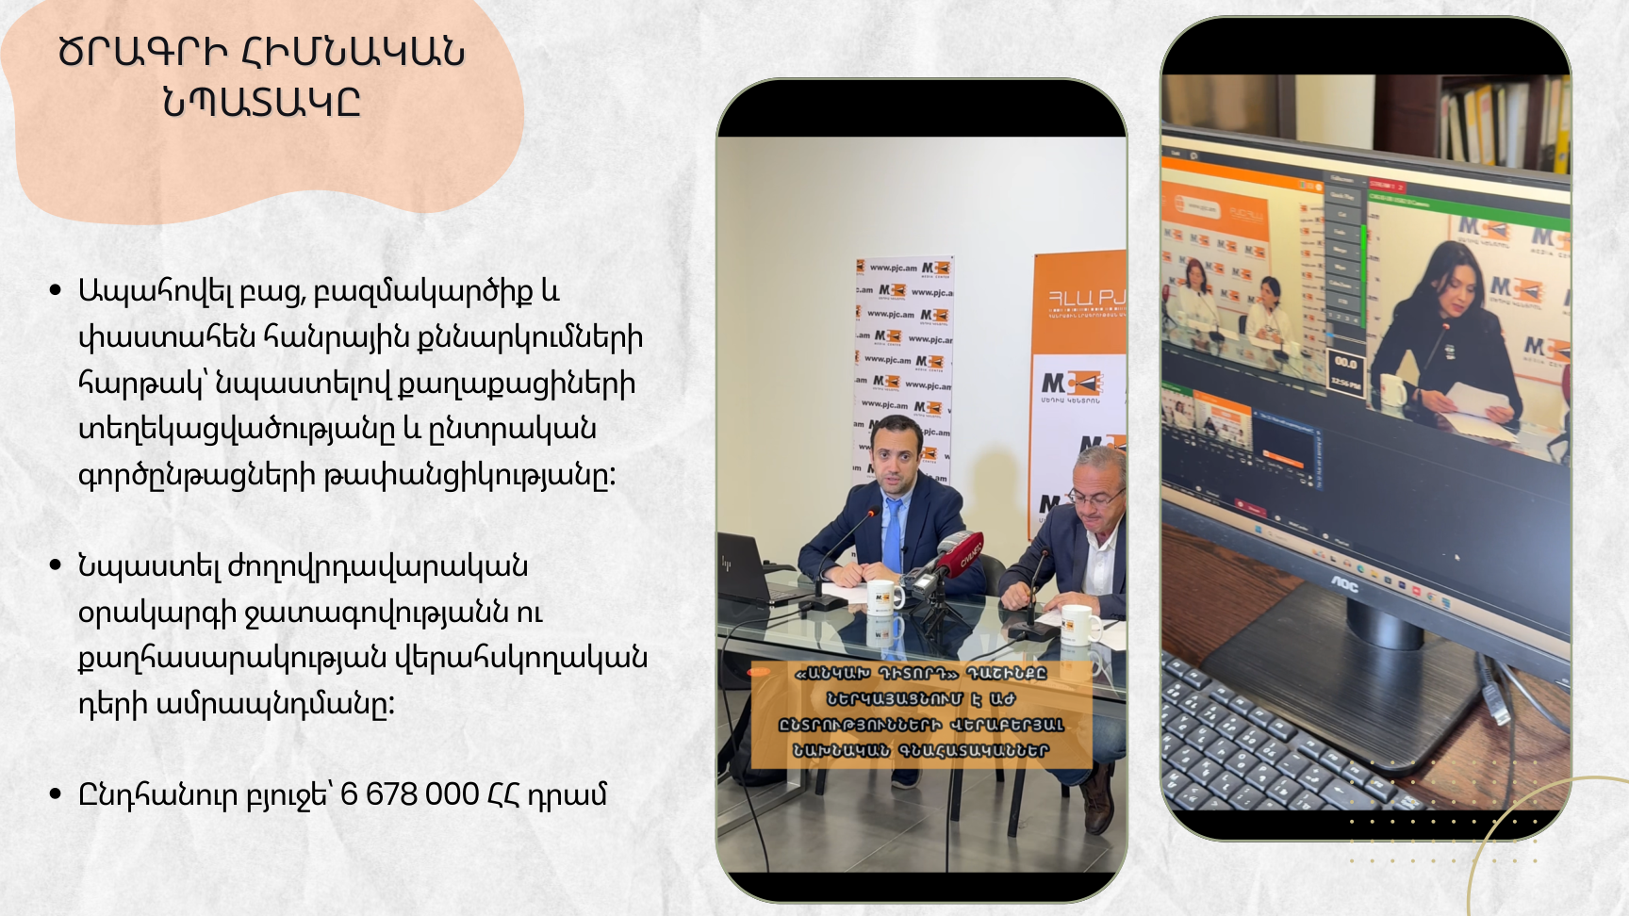
MAIN PROJECT
OBJECTIVE
Safeguard transparency, competitiveness and informed democratic participation ahead of Armenia’s 2026 parliamentary elections by restoring the Media Center as a trusted, non-partisan platform for rapid public deliberation and effective civil society communication.
• Provide an open, pluralistic and evidence-based space for public discussion and citizen information.
• Strengthen advocacy around the democratic agenda and reinforce civil society’s watchdog role.
TOTAL BUDGET
AMD 6,678,000

Slide 4
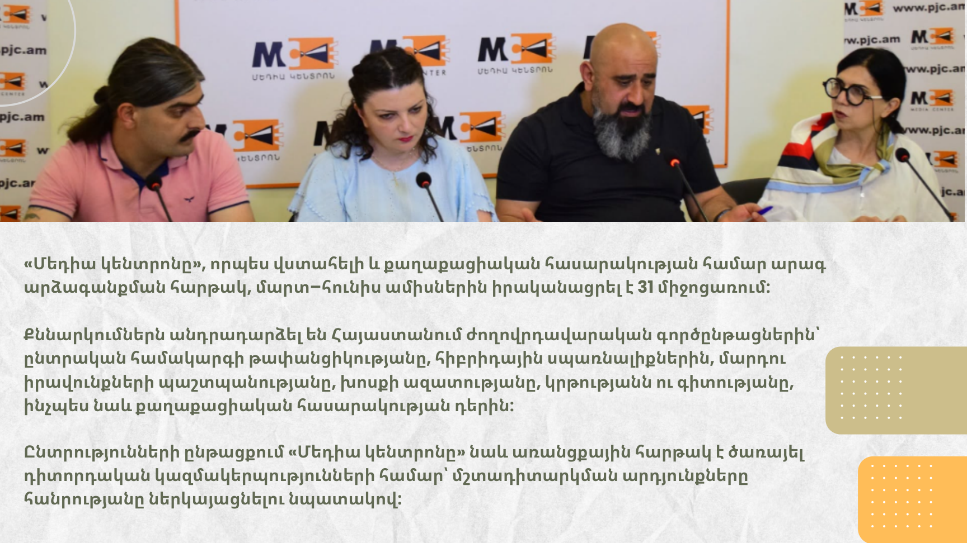
31 EVENTS | MARCH–JUNE 2026
As a trusted rapid-response platform for civil society, the Media Center held 31 events from March to June.
Discussions focused on democratic processes in Armenia, including electoral transparency, hybrid threats, human rights protection, freedom of expression, education and science, and the role of civil society.
During the elections, the Media Center also served as a key platform for election observation partners to present their monitoring findings to the public.

Slide 5
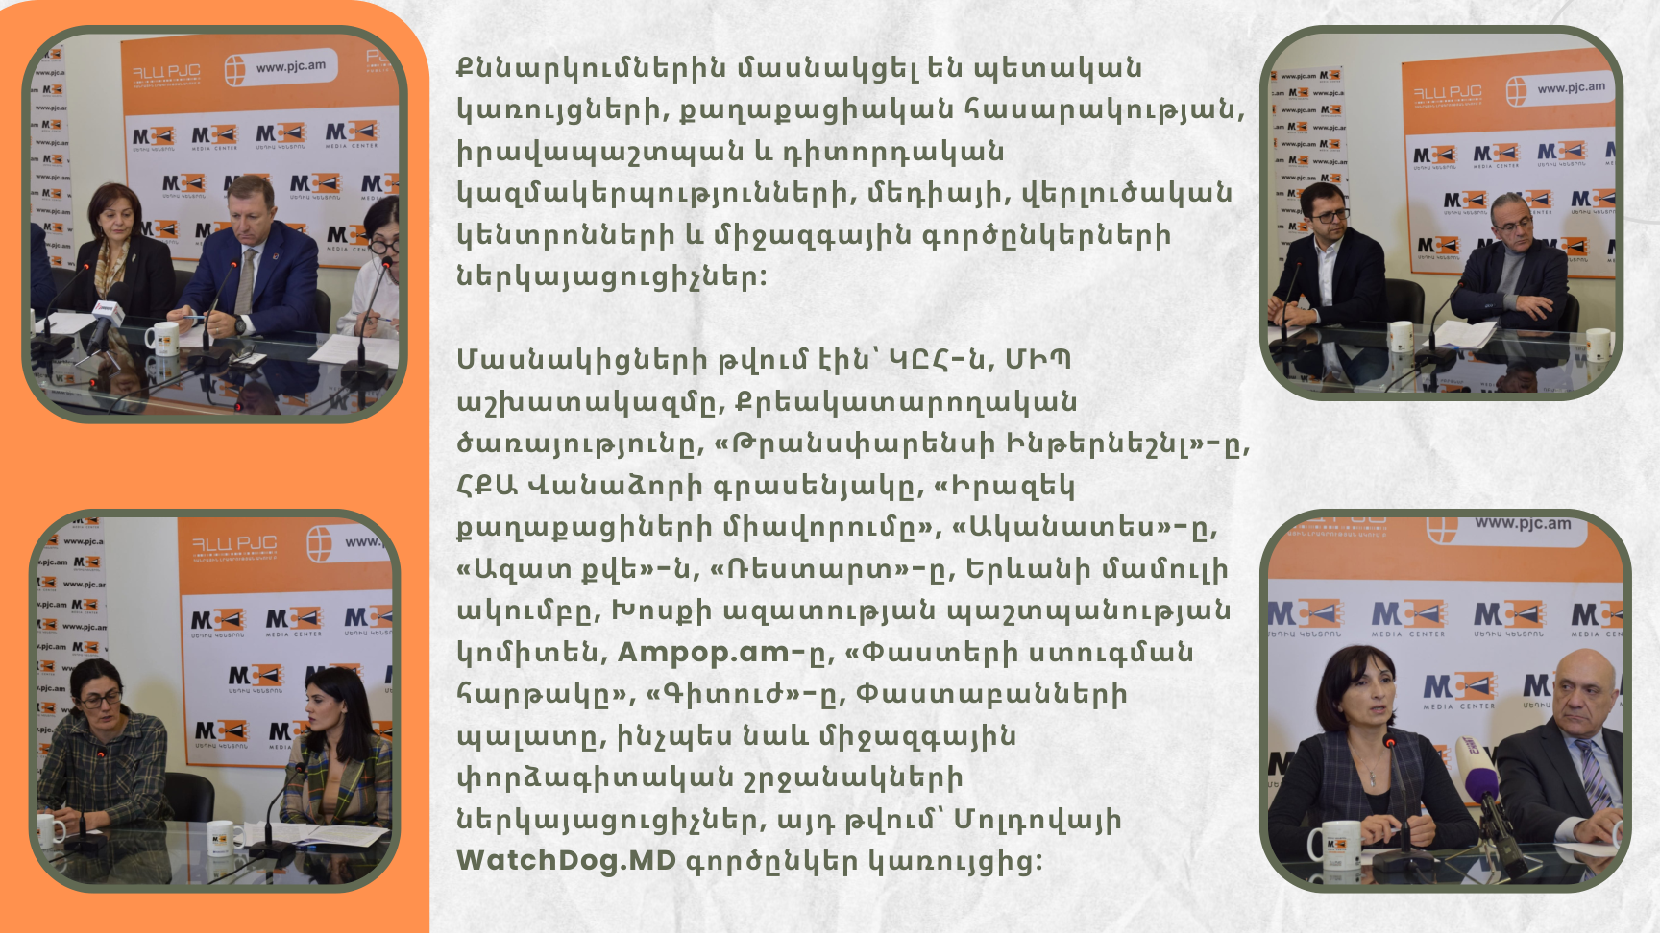
WHO TOOK PART?
Participants represented state institutions, civil society, human rights and election observation organizations, media, think tanks and international partners.
State institutions
Central Electoral Commission (CEC)
Human Rights Defender’s Office
Penitentiary Service
Civil society & observers
Transparency International
Helsinki Citizens’ Assembly–Vanadzor
Union of Informed Citizens
Akanates • Free Vote • Restart
Media & professional bodies
Yerevan Press Club
Committee to Protect Freedom of Expression
Ampop.am • Fact Investigation Platform
Gituzh Initiative • Chamber of Advocates
International expertise
Analysts and expert communities, including the Moldova-based partner WatchDog.MD.

Slide 6

SUSTAINABILITY CHALLENGE
The Media Center remains a trusted and in-demand platform, but after the project concludes, its active operations will again be paused until a new funding opportunity becomes available.

Slide 7
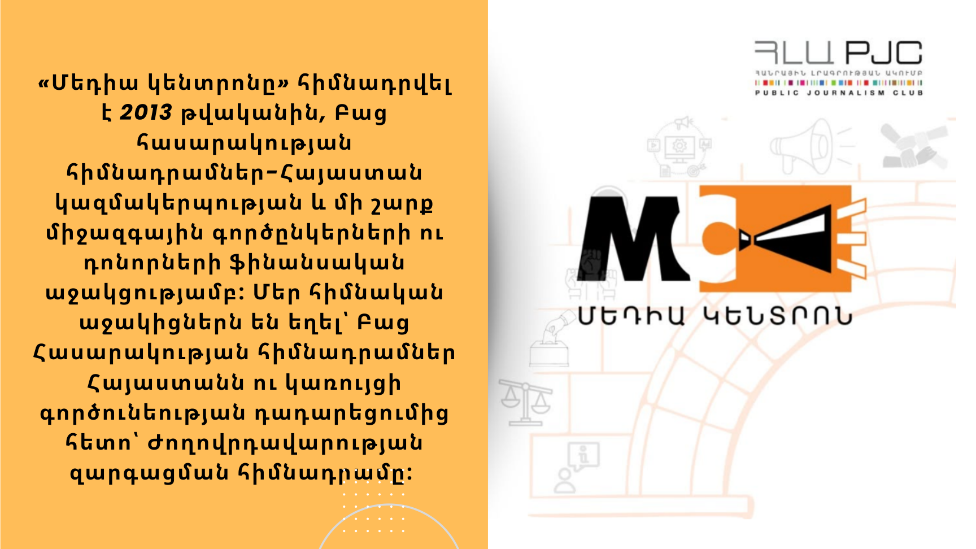
MEDIA CENTER
SINCE 2013
The Media Center was established in 2013 with financial support from Open Society Foundations–Armenia and a number of international partners and donors.
Its principal supporter was Open Society Foundations–Armenia and, following the closure of the foundation’s operations in Armenia, the Democracy Development Foundation.

Slide 8

THANK YOU FOR YOUR SUPPORT
AND COOPERATION
PJC website

